Slide 1
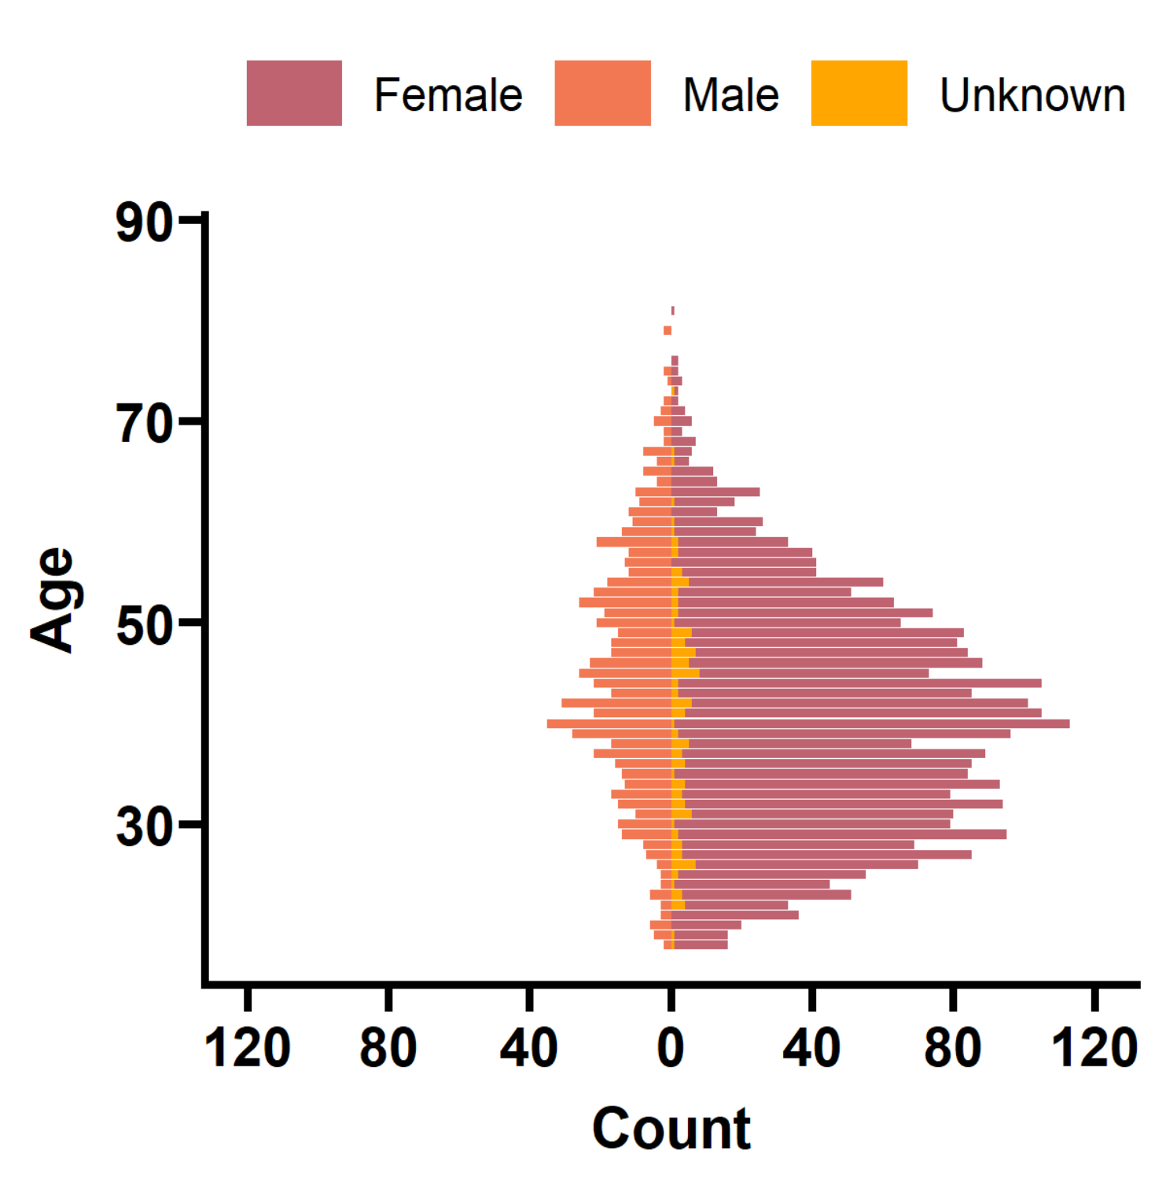
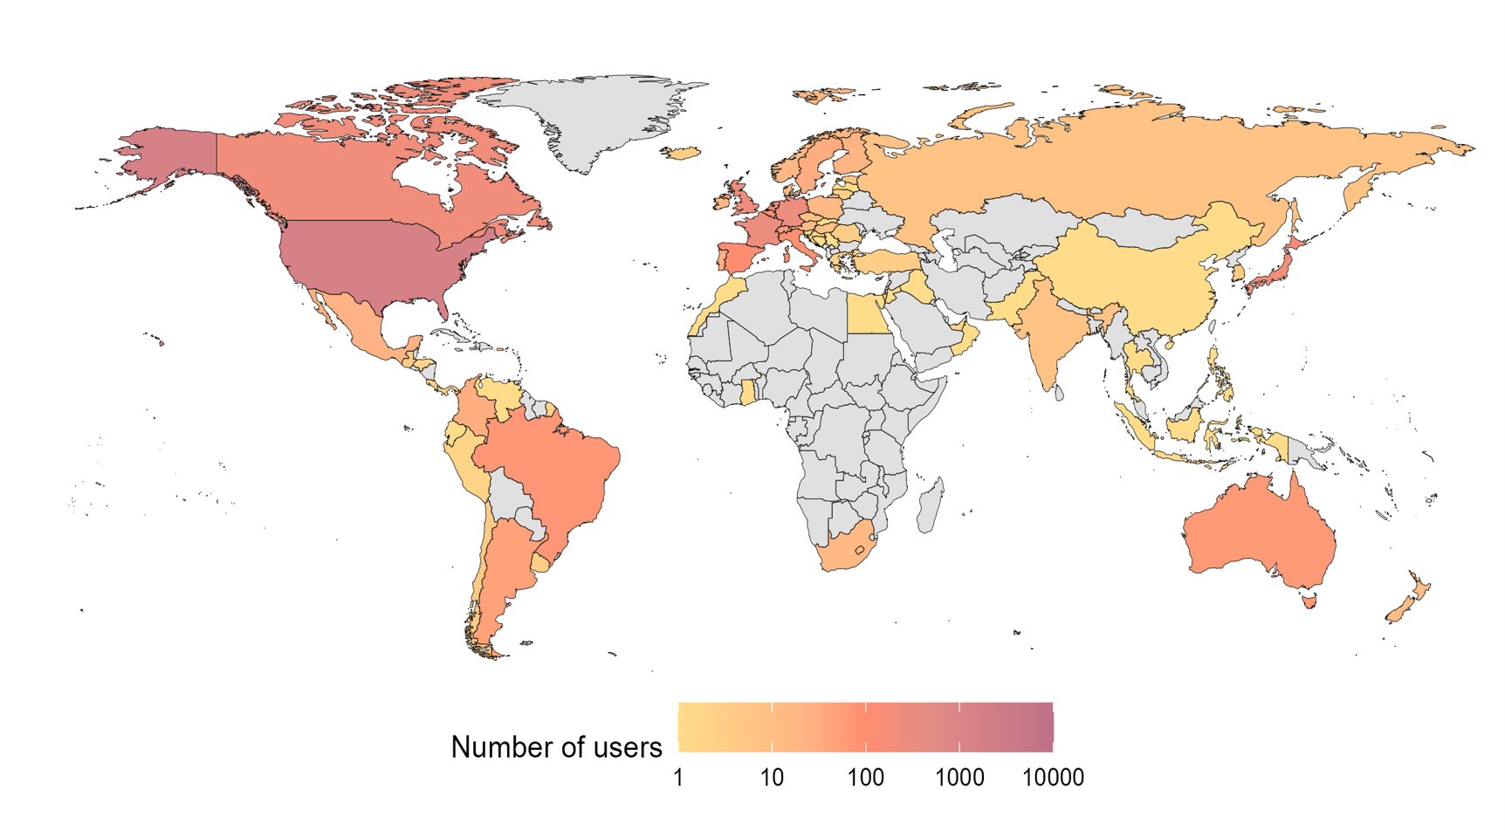
Demographics

Slide 2
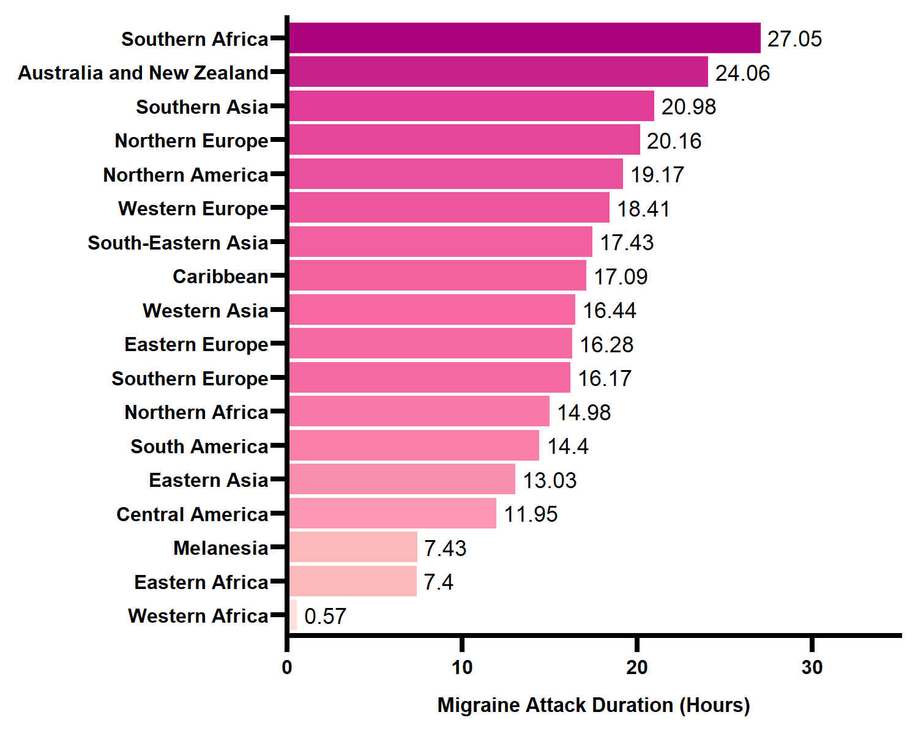
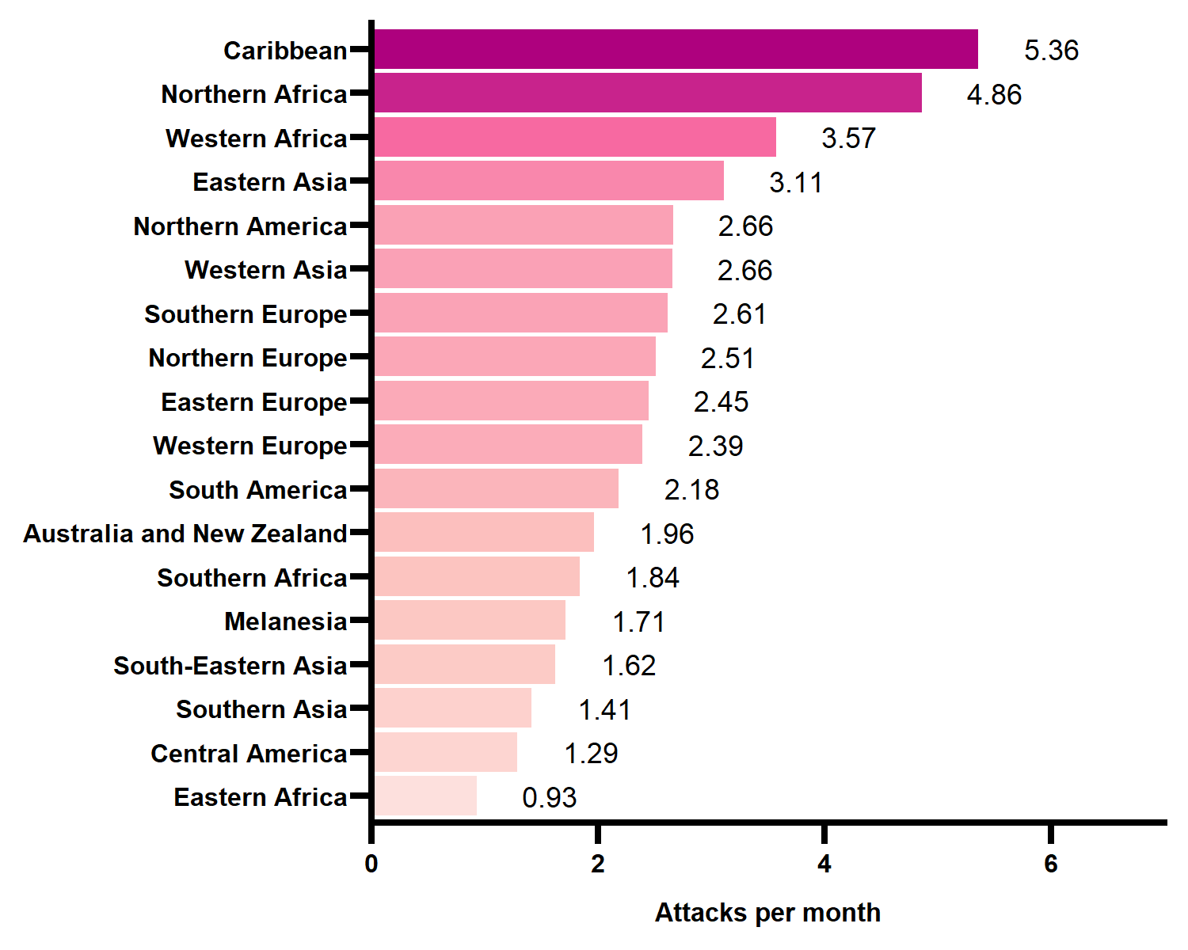
Migraine Attacks Per Month & Duration

Slide 3
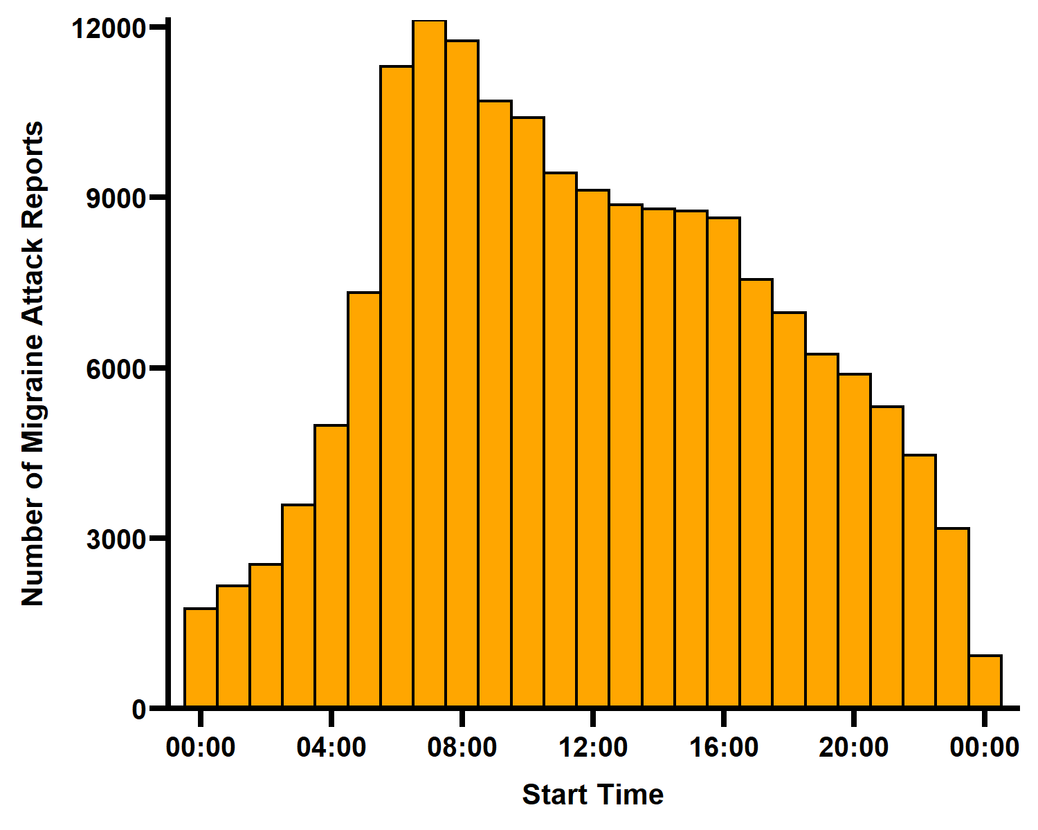
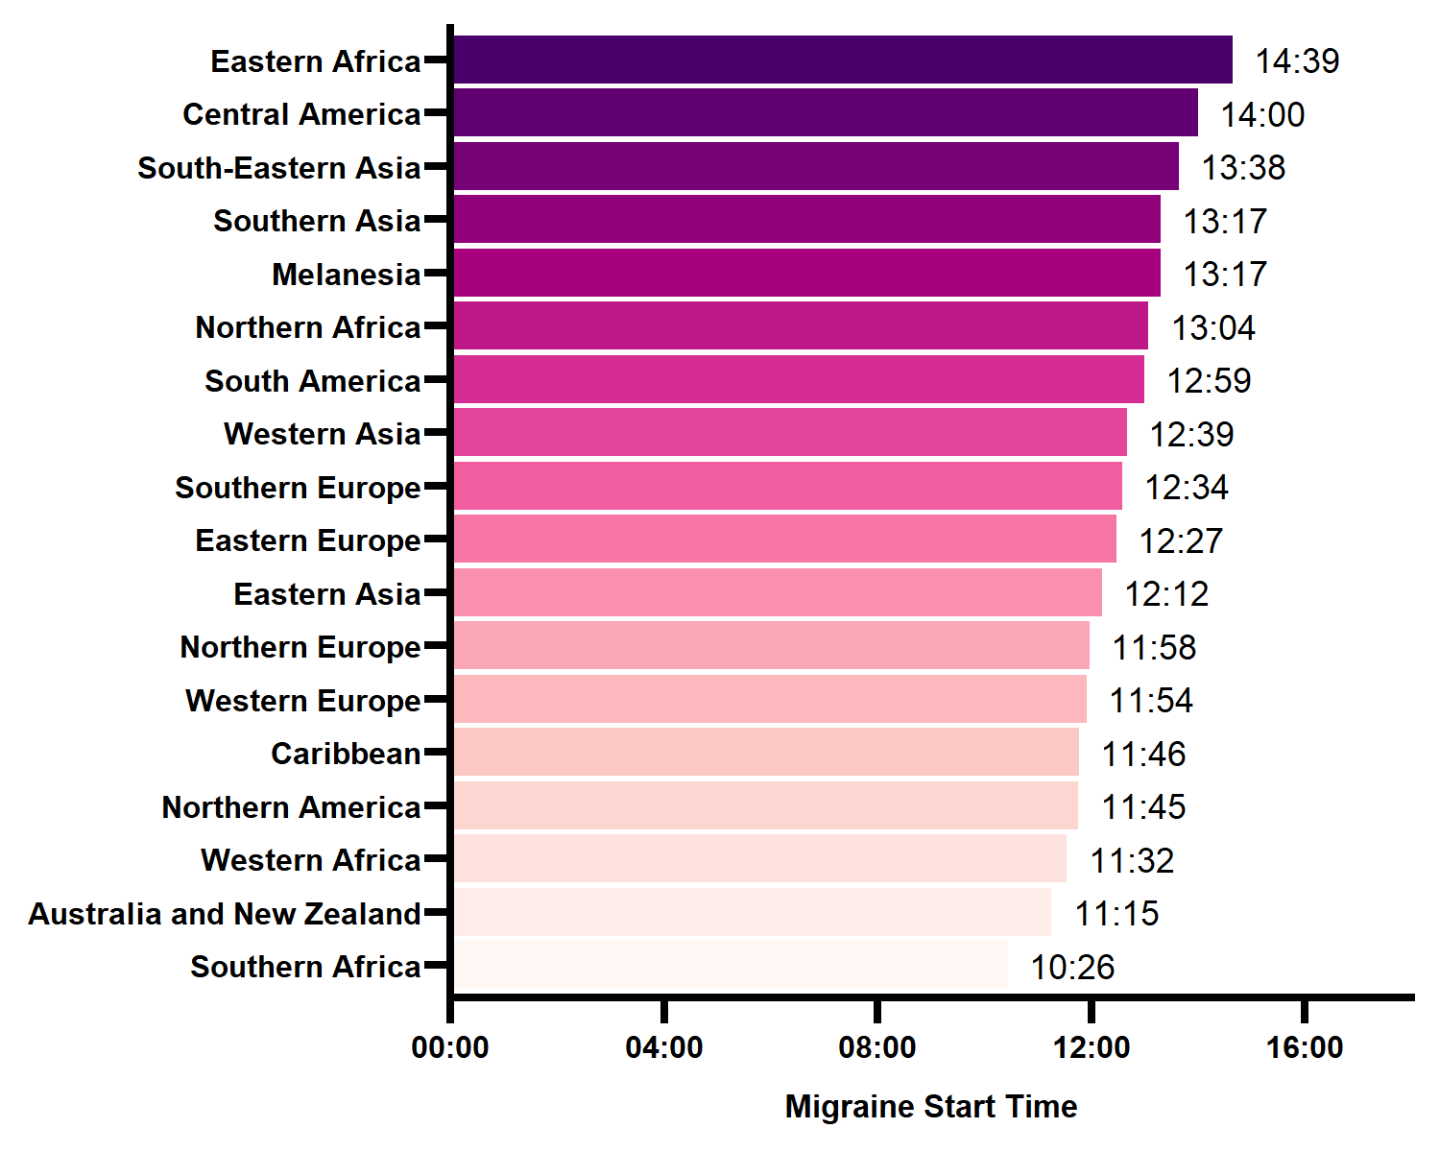
Migraine Start Time

Slide 4
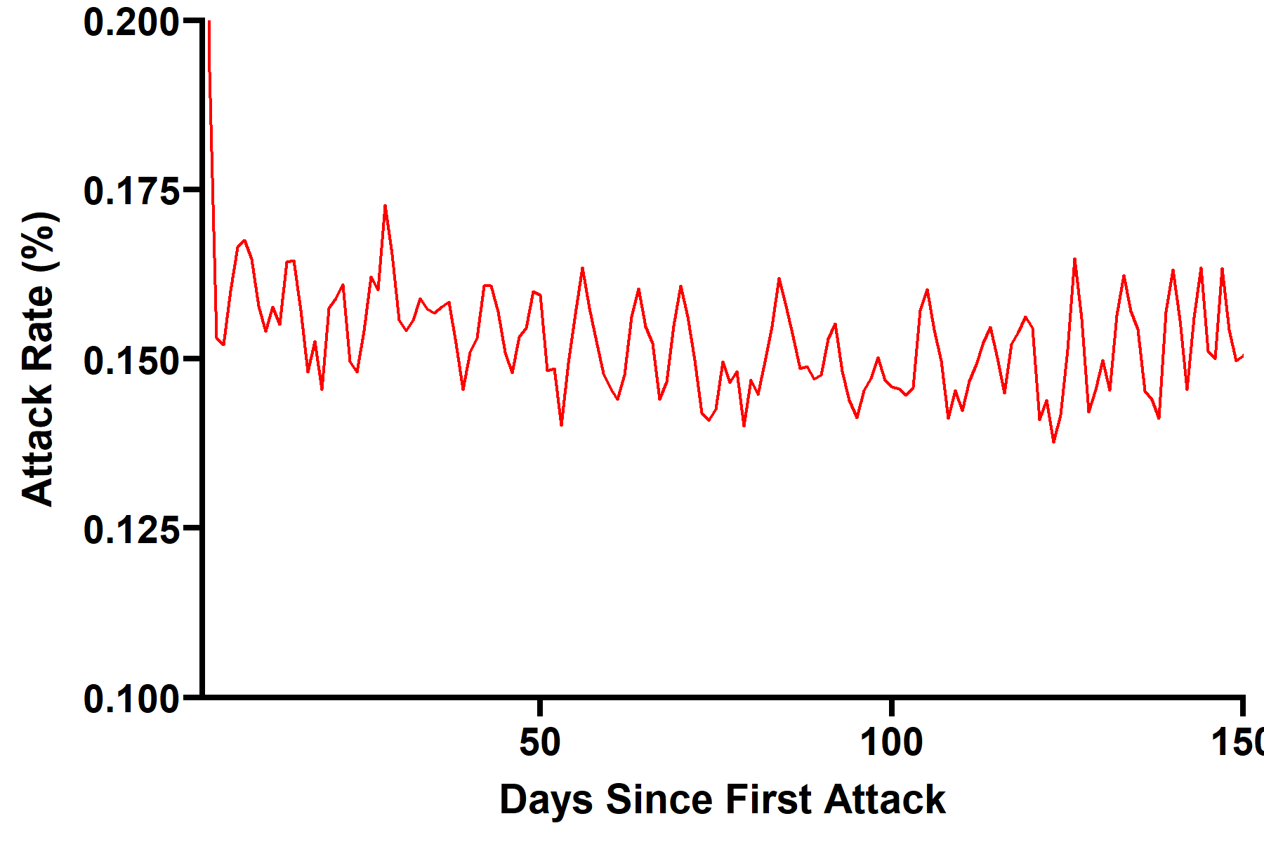
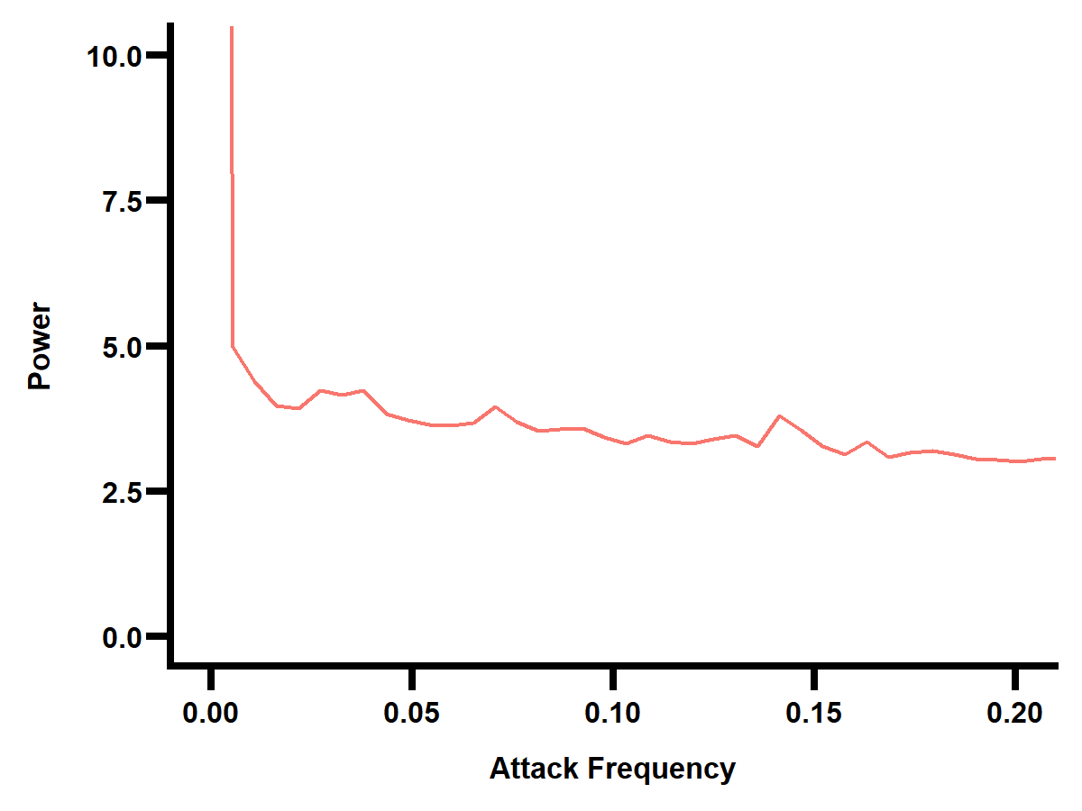
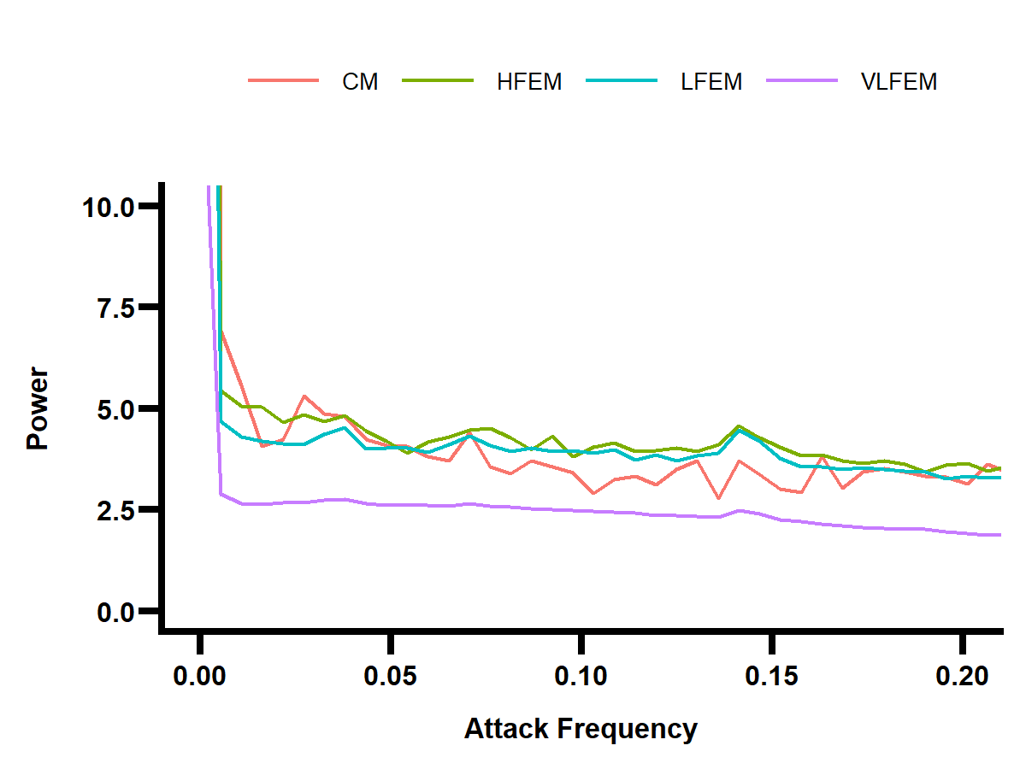
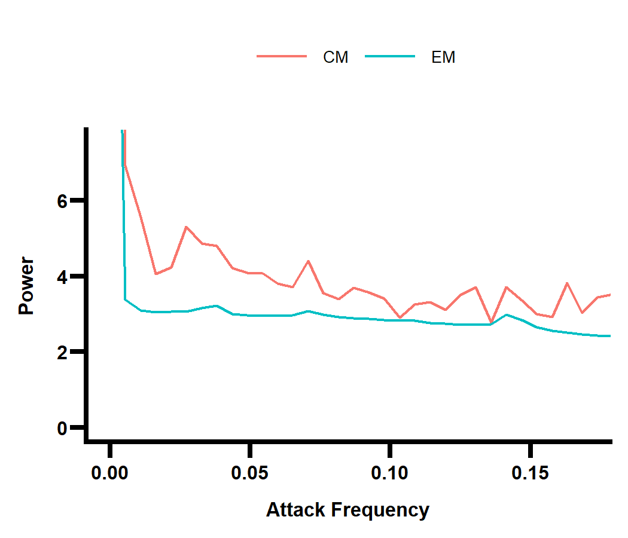
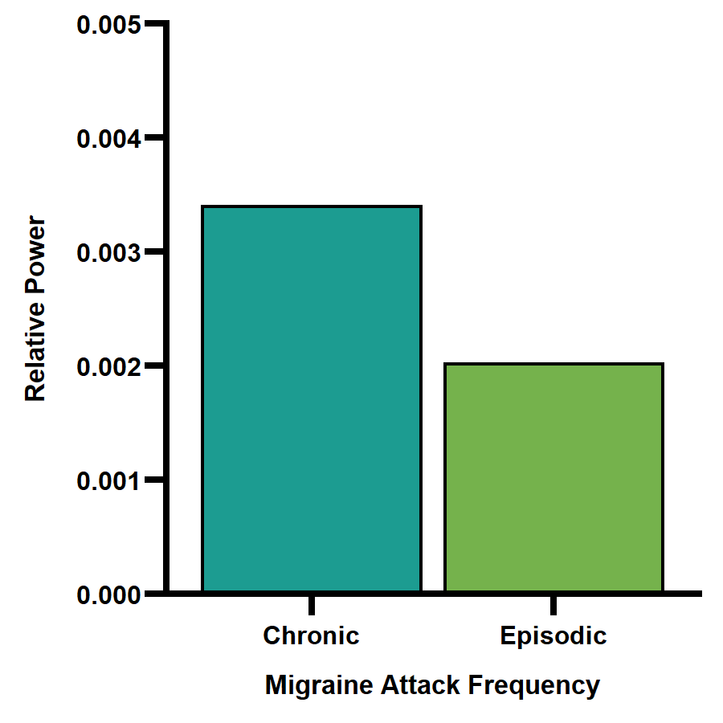
7 days
7 days

Slide 5
Plot sleep on week / weekend

Slide 6
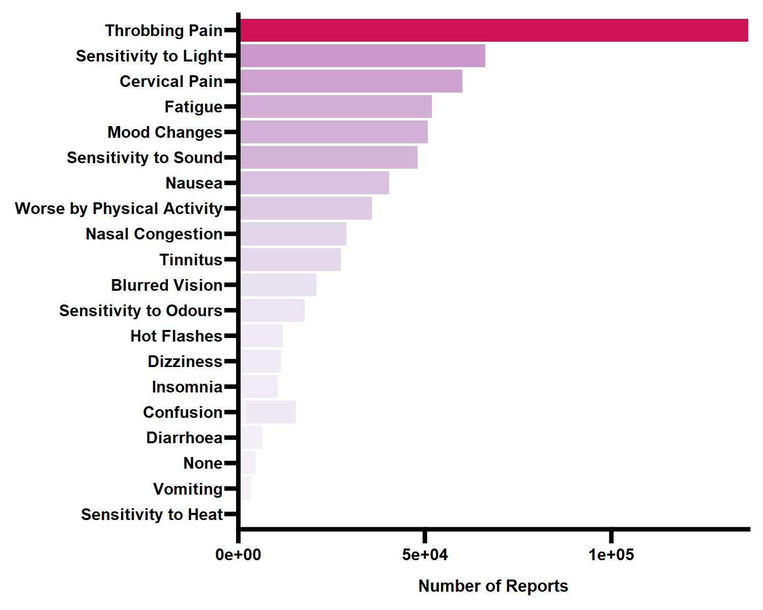
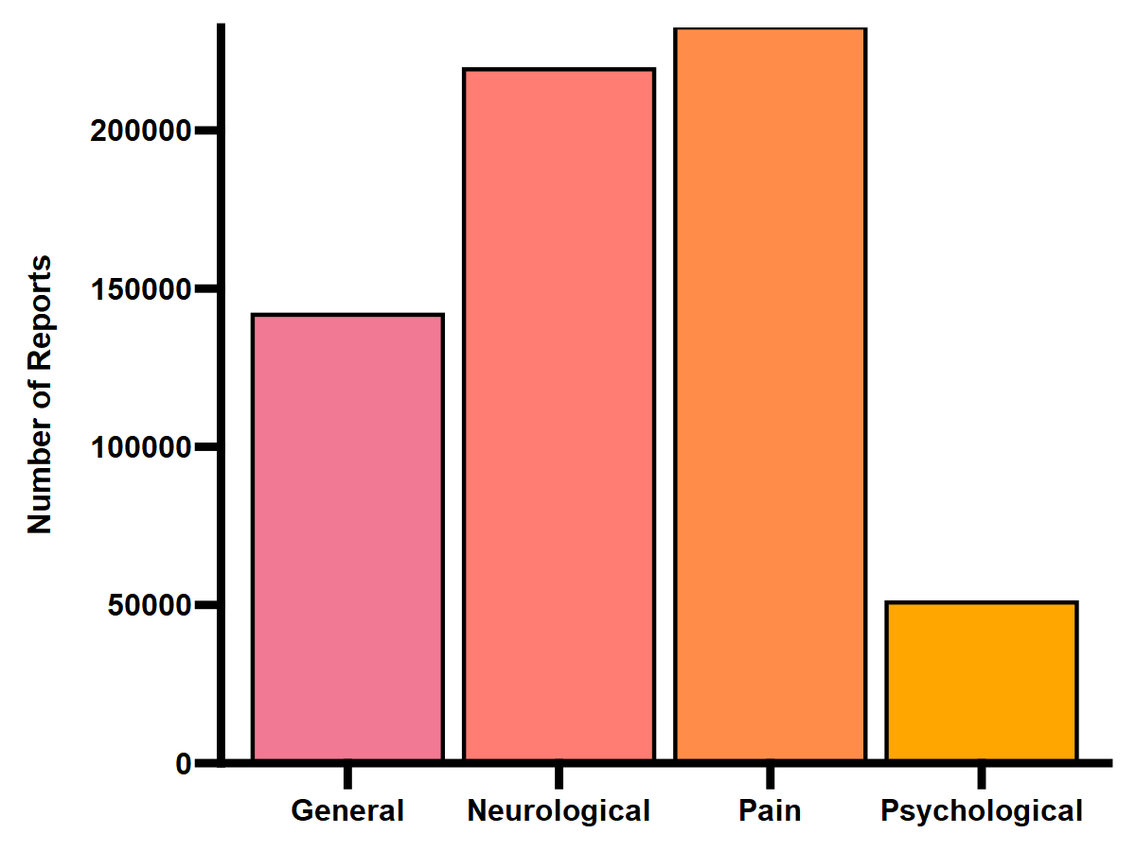

Slide 7
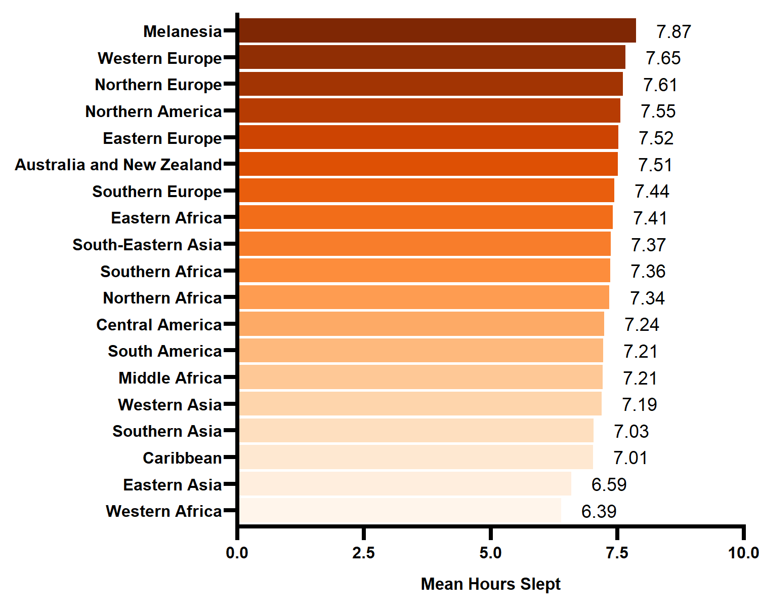
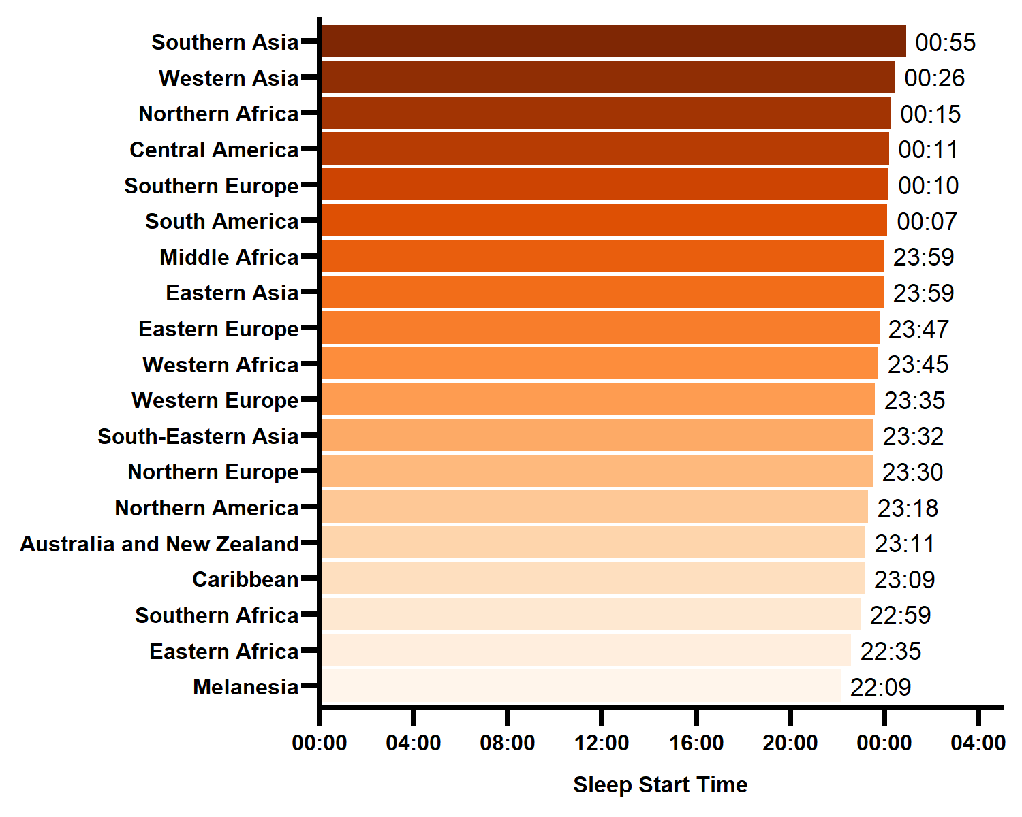
Hours Slept & Sleep Start Time

Slide 8
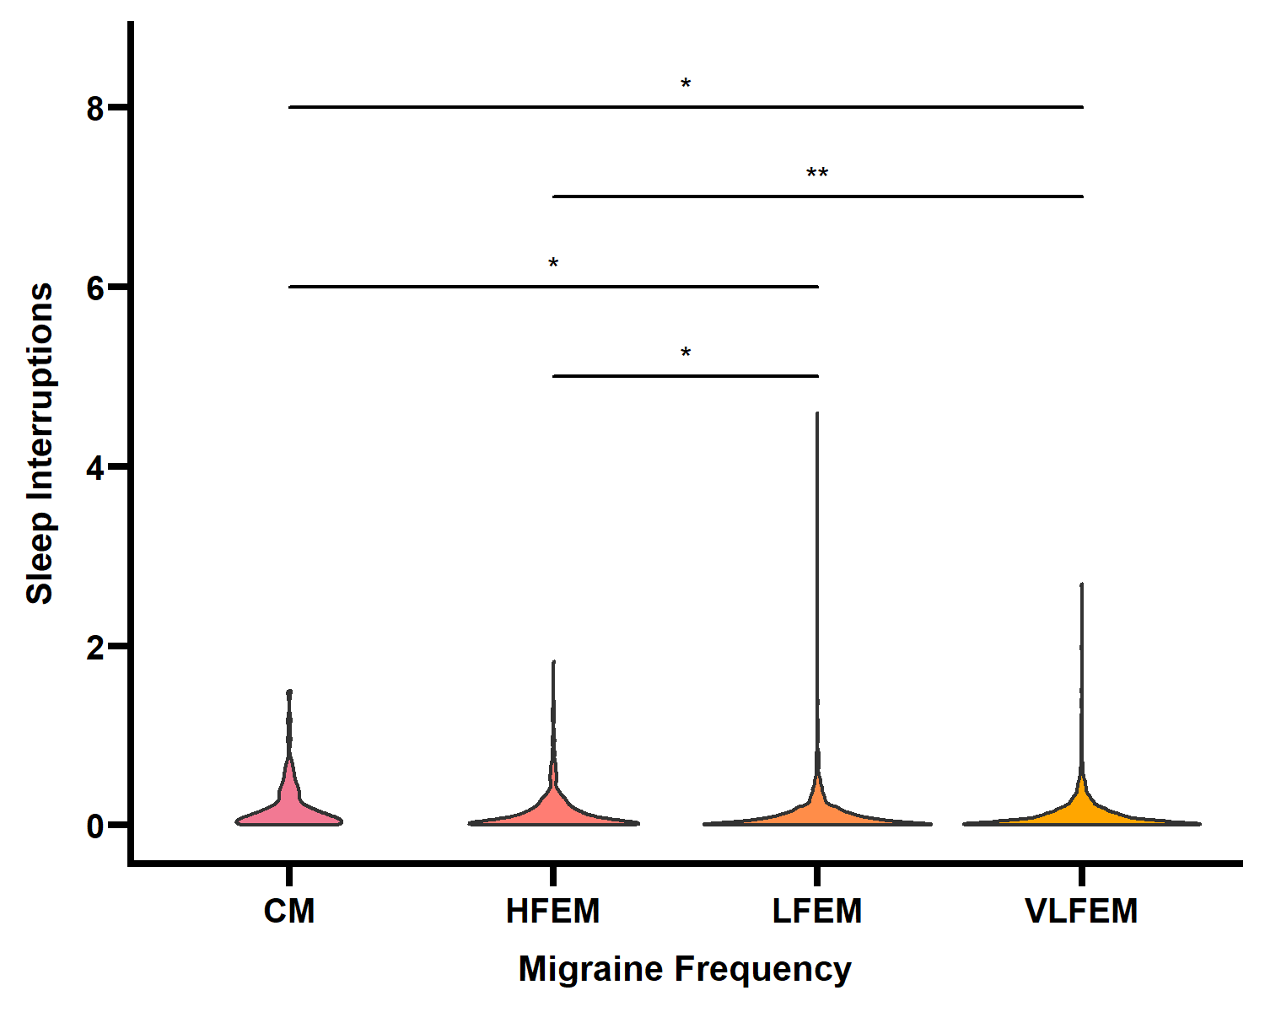
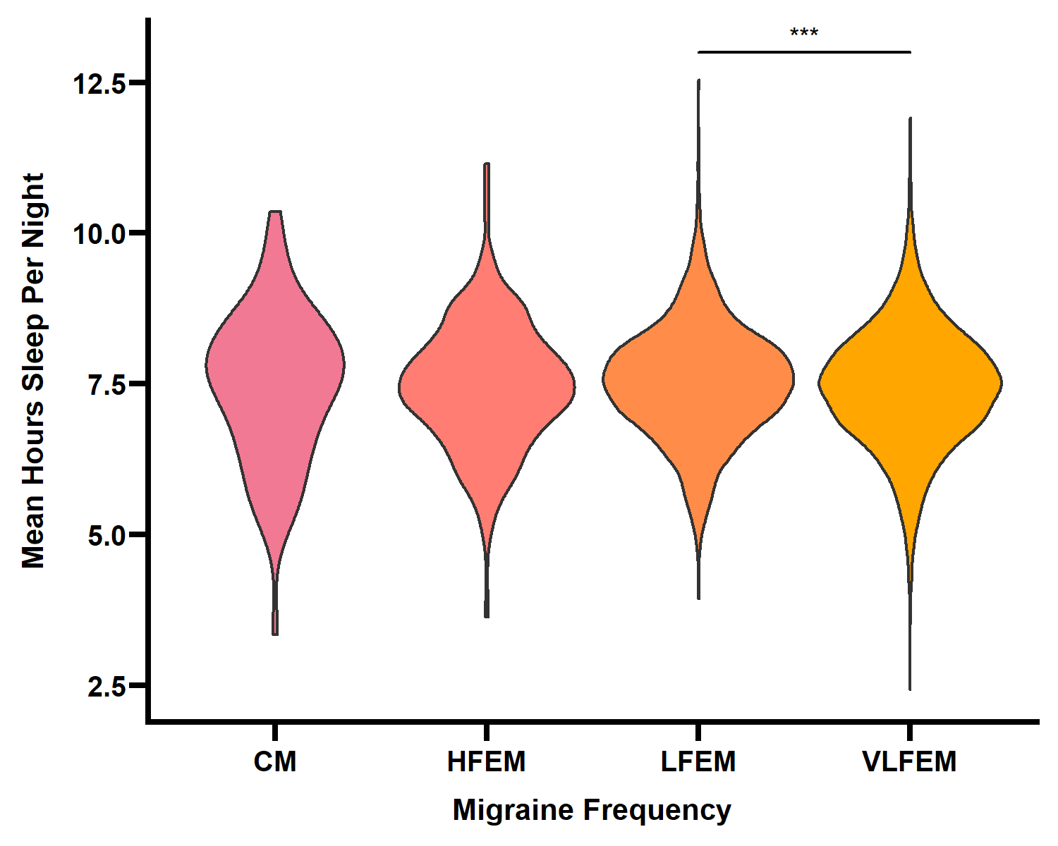
Sleep According to Migraine Frequency

Slide 9
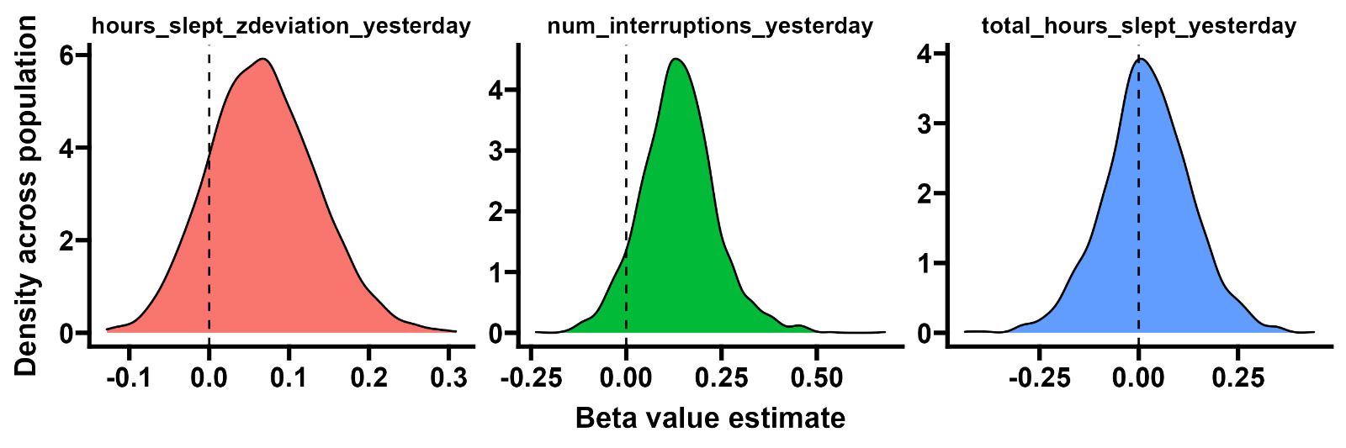
Can changes in sleep predict a migraine attack?
Deviation from a user’s mean sleep the night before is a significant predictor of a migraine attack occurring
Greater deviation from typical sleep = more likely an attack is to occur
Number of interruptions in sleep the night before is a significant predictor of a migraine attack occurring the next day.
Greater sleep fragmentation = more likely an attack is to occur
Total hours slept the night before is not a significant predictor of a migraine attack occurring the next day.
Sleep duration does not make an attack more or less likely to occurr

Slide 10
Can migraine variables predict poor sleep?

Slide 11
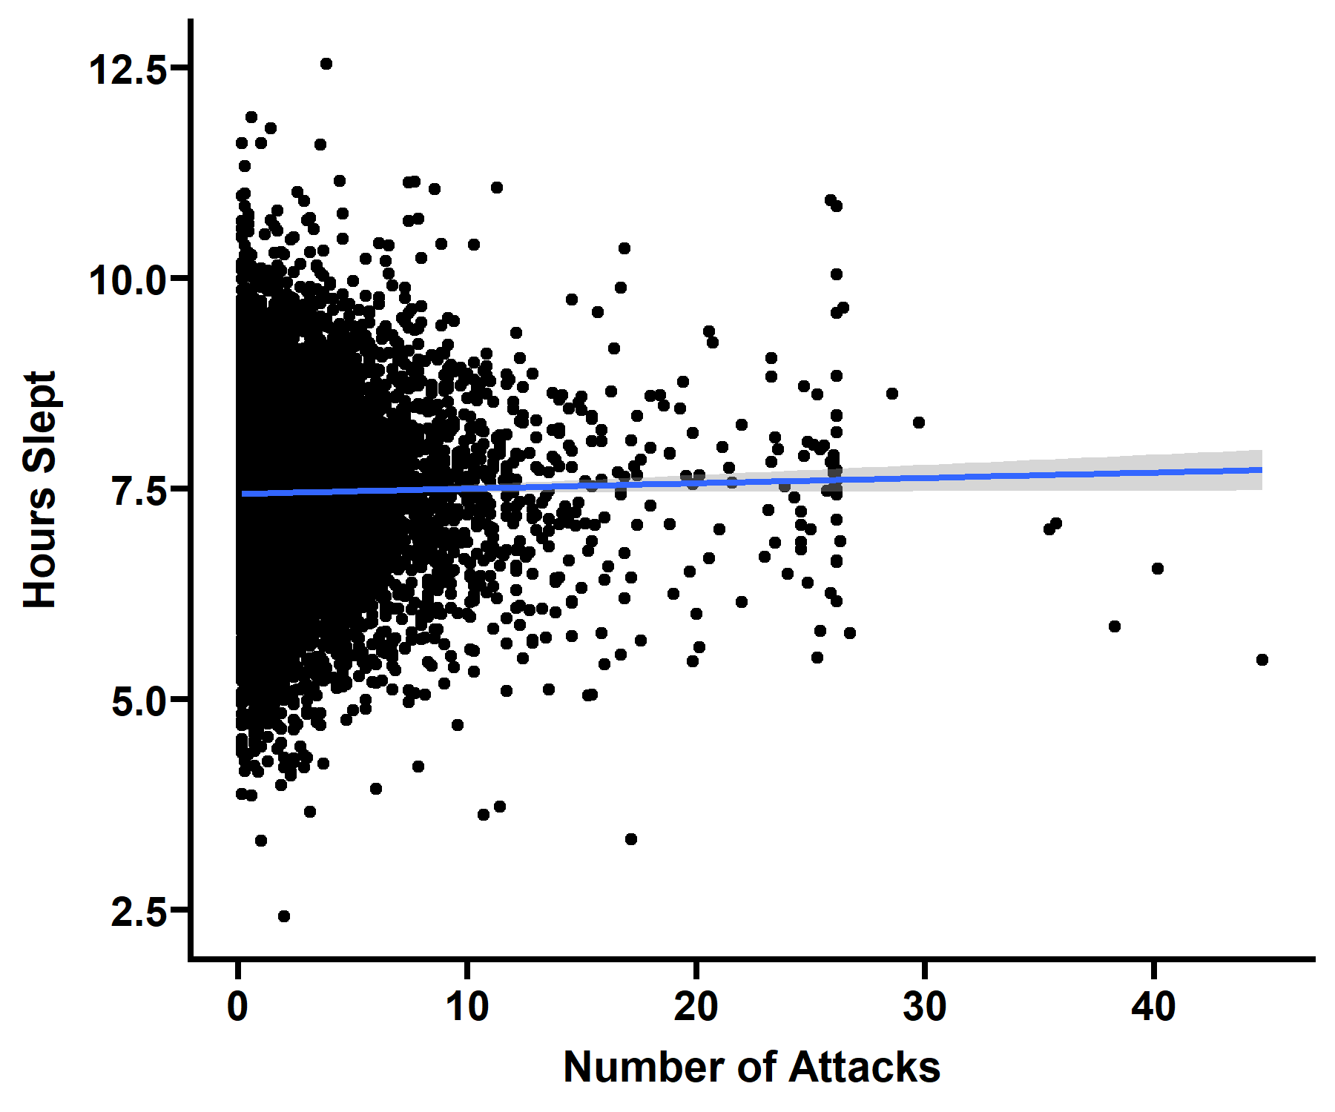
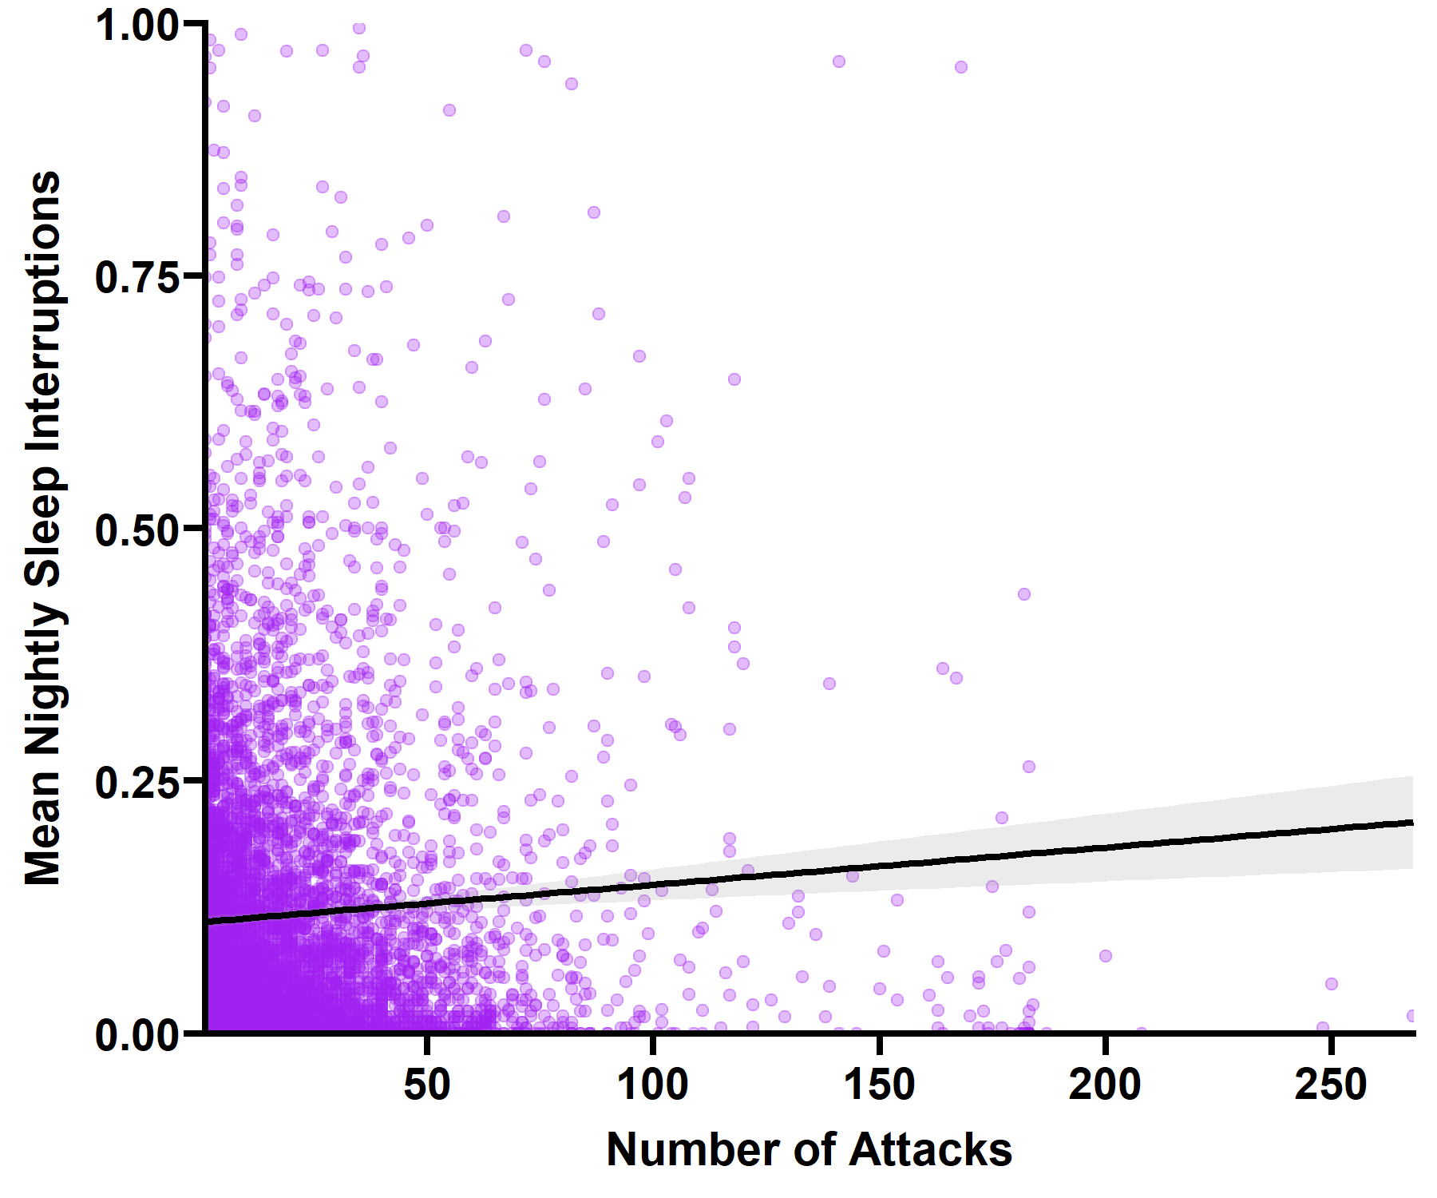
Correlations – not sure if we need these anymore as we have the modelling instead

Slide 12
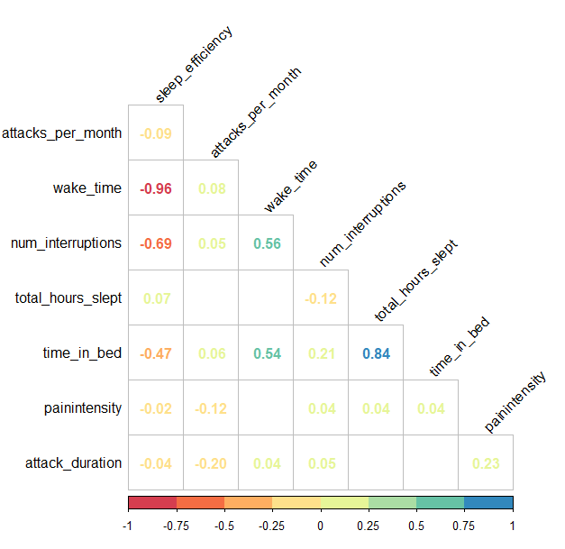
Correlations – not sure if we need these anymore

